Slide 1

Honeypot
By: Yaniv Bartov
Student at JCT, Jerusalem

Slide 2


The problem
1.76 billion
14 seconds

Slide 3

What is a honeypot?
Honeypot is used as a decoy to lure cyber attackers and detect, deflect and study hacking attempts.

Slide 4


What can honeypots used for?
# To capture information from
unauthorized intruders
# To research the behavior
of cyber attackers
Useful in other fields #

Slide 5

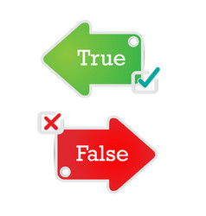
Effective protection
Fewer false positives

Slide 6


Not just security
Fake Wi-Fi network
Spam traps

Slide 7


The best defense is an attack
Real data collection
Encryption passing

Slide 8
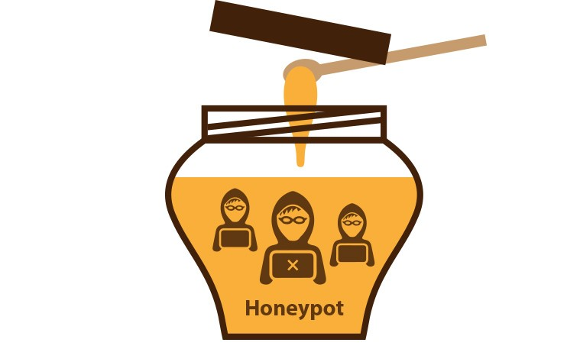

Summary
The threats are getting bigger.
Honeypot must be part of any security system.

Slide 9
THANK YOU!
Stay in contact with me:
yaniv051293@gmail.com | 054-2694196

